Slide 1




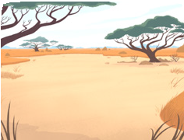
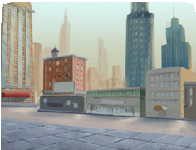




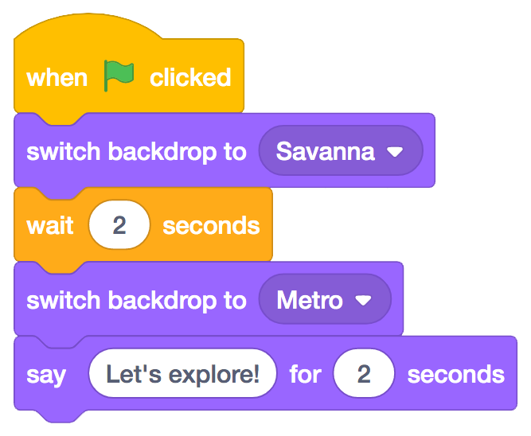
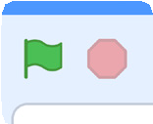

Change Backdrops
scratch.mit.edu
GET READY
Choose two backdrops.
Choose a sprite.
Savanna
Metro
Avery
ADD THIS CODE
Avery
Choose the backdrop you want to start with.
Choose the second
backdrop.
Type what you want to say.
TRY IT
Click the green flag to start.
Create a Story

